Slide 1
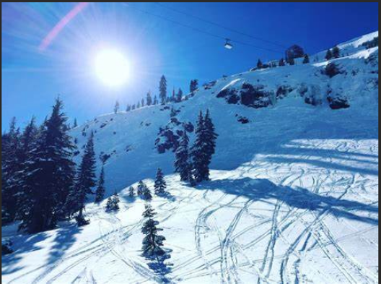
Big Montana Resort
Tickets pricing strategy

Slide 2
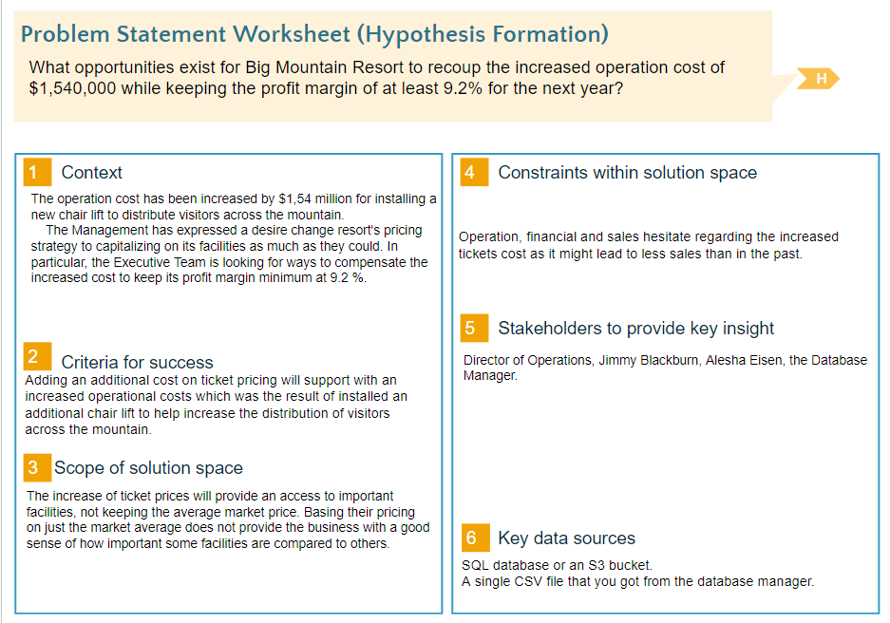

Slide 3
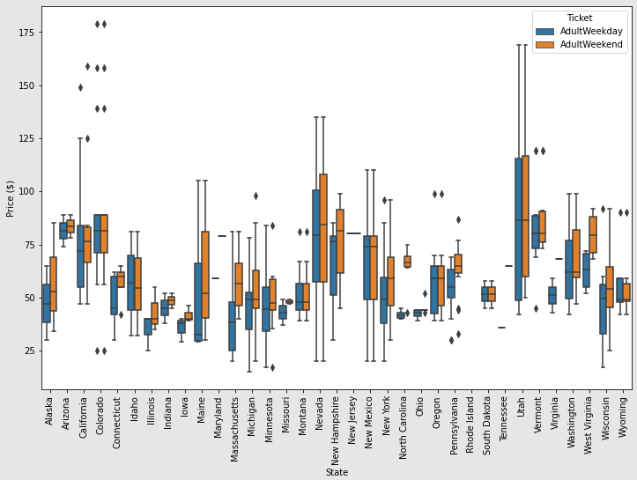
Recommendation and key findings
Distribution of weekday and weekend price by state shows as below:
In Montana we found that the average ticket price is the same ($81) during weekends and weekdays and are cheaper in comparison with others. Most states have different price variations between Weekends and Weekdays. In majority of them weekends prices are higher than weekdays.

Slide 4
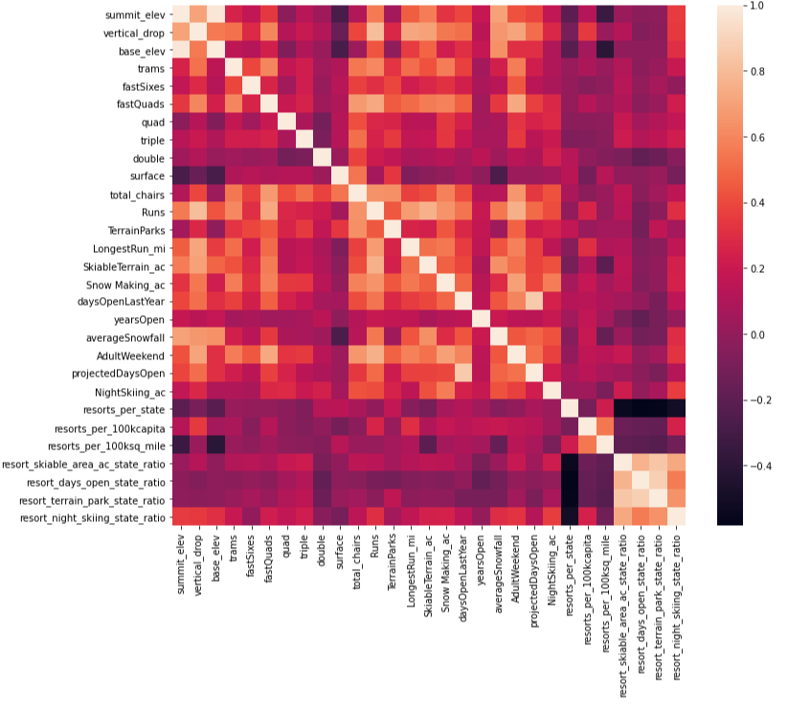
Modelling results and analysis
Turning your attention to your target feature, AdultWeekend ticket price, you see quite a few reasonable correlations. fastQuads stands out, along with Runs and Snow Making_ac. The last one is interesting. Visitors would seem to value more guaranteed snow, which would cost in terms of snow making equipment, which would drive prices and costs up.
Of the new features, Resort_night_skiing_state_ratio seems the most correlated with ticket price. If this is true, then perhaps seizing a greater share of night skiing capacity is positive for the price a resort can charge.
As well as Runs, total_chairs is quite well correlated with ticket price. This is plausible; the more runs you have, the more chairs you'd need to ferry people to them! Interestingly, they may count for more than the total skiable terrain area. For sure, the total skiable terrain area is not as useful as the area with snow making.

Slide 5
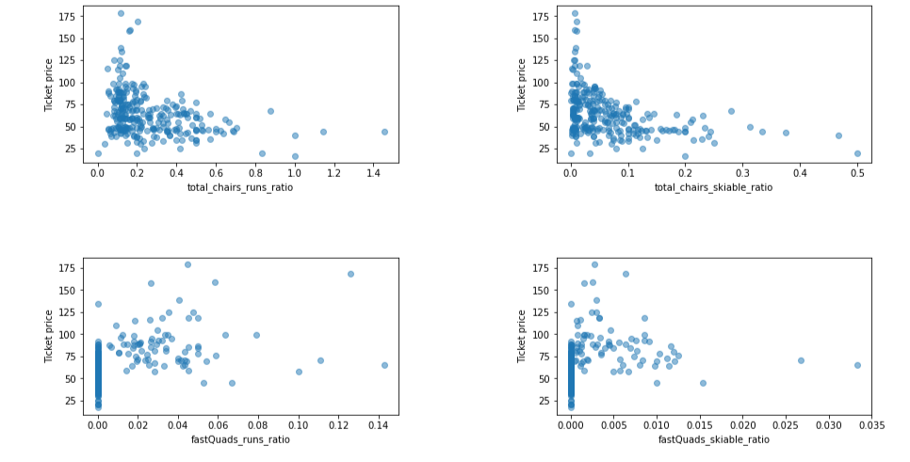
Modelling results and analysis
It seems that the more chairs a resort has to move people around, relative to the number of runs, ticket price rapidly plummets and stays low. What we may be seeing here is an exclusive vs. mass market resort effect; if you don't have so many chairs, you can charge more for your tickets, although with fewer chairs you're inevitably going to be able to serve fewer visitors. Your price per visitor is high but your number of visitors may be low. Something very useful that's missing from the data is the number of visitors per year.
It also appears that having no fast quads may limit the ticket price, but if your resort covers a wide area then getting a small number of fast quads may be beneficial to ticket price.

Slide 6
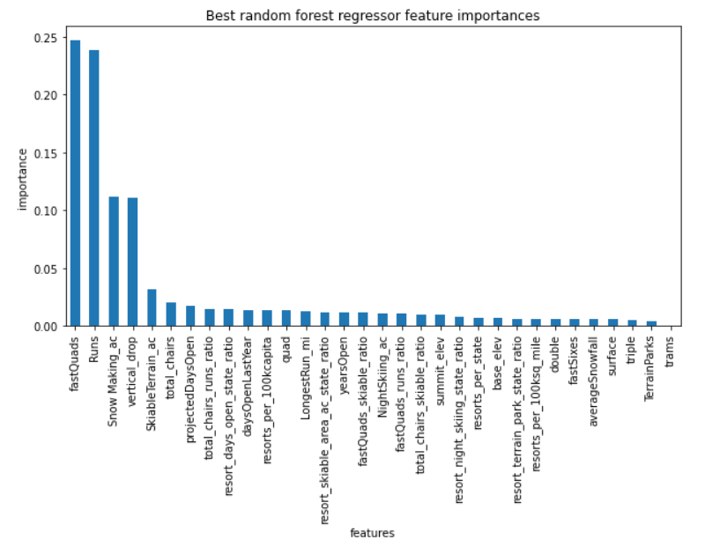
Modeling results and analysis
Big Mountain Resort modelled price is $94, actual price is $81.00.
Even with the expected mean absolute error of $10.26, this suggests there is room for an increase.
Encouragingly, the dominant top four features are in common with your linear model:
fastQuads
Runs
Snow Making_ac
vertical_drop
The random forest model has a lower cross-validation mean absolute error by almost $1. It also exhibits less variability. Verifying performance on the test set produces performance consistent with the cross-validation results.

Slide 7
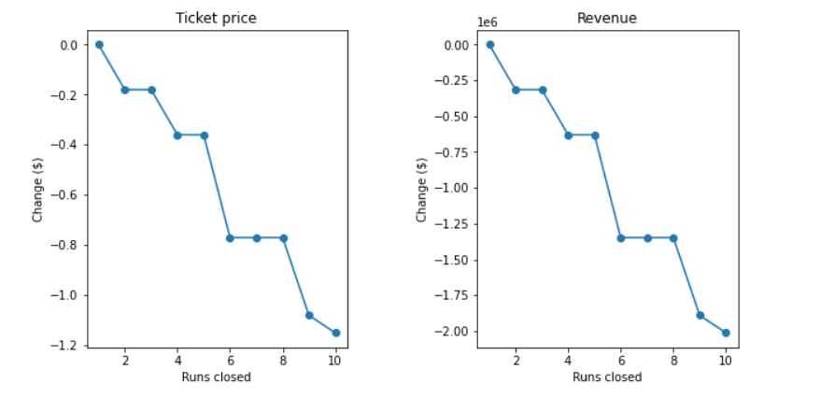
Summary and conclusion
Conclusion
The model does not take into account the operational costs and expenditure for adding increasing the vertical drop by 150 feet, and installing an additional chair lift. We only know that additional chair lift would increase the operating cost by $1.54 million. The model says closing one run makes no difference. Closing 2-3 will reduce the ticket price and revenue. If they close 3, then they can close 4 and 5 runs as there will no loss on ticket pricing. The significant drop will be if 6 runs will be closed.
Future scope of work.
After Calculating Expected Big Mountain Ticket Price from The Model, Our model suggests that the modelled price should be $93.93, $94 if we round it. Even with the expected mean absolute error of $10.26, this suggests there is room for an increase. Meaning that we could increase the price for $10-15, which will support with expenditure for maintenance, operation and other costs. Also, importantly could help us to improve the facility.
Increased price will attract less people, but those who value the quality and better facility. This makes easier to maintain the resort and improve the services of the facility.
Adult ticket is currently priced at $81 and average visitors ski for 5 days and 350,000 visitors in the coming season, the model predicts $19635175 increase in revenue from raising the ticket price by $11.22 by adding a run, increasing the vertical drop by 150 feet, and installing an additional chair lift.

